Slide 1
FoodSource
Proposal
Adam Zabloudil

Slide 2


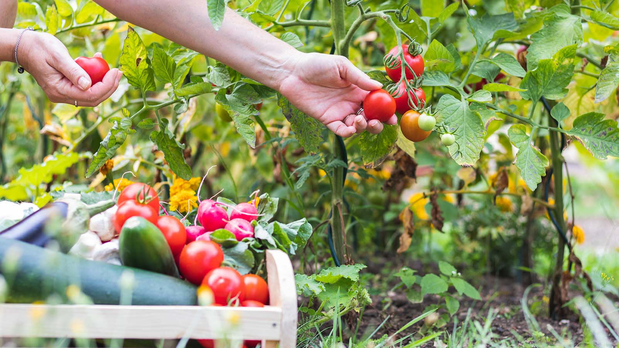
What is FoodSource?
iOS App
Marketplace to buy/sell food directly from its source
Buyers:
People who want convenient access to organic, ethically sourced food
Sellers:
Farmers, gardeners, hunters, fisherman, beekeepers, etc.
How it works:
Sellers upload listings of their food
Buyers pay through the app
They decide on either pickup, drop off, or shipping

Slide 3
Why this project?
Mobile development, database systems
Nutrition
Wanted to use a service like this

Slide 4



Technologies
SwiftUI - Frontend
Firebase - Backend
Stripe - Payment Processing / Payouts
Package Tracking API - Track Shipping

Slide 5
Questions?

